Slide 1


Vs.
Joe
George

Slide 2


Slide 3


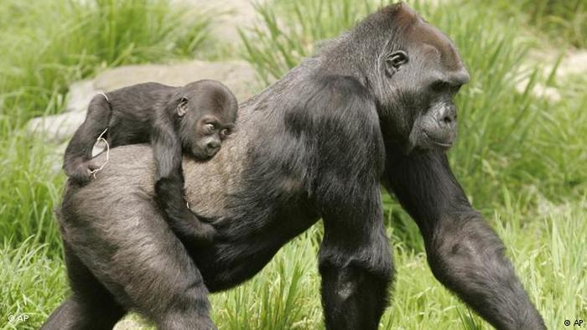

Slide 4

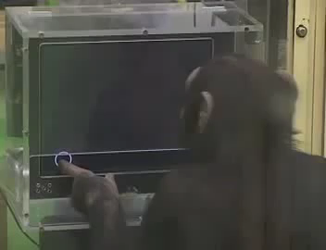

Slide 5
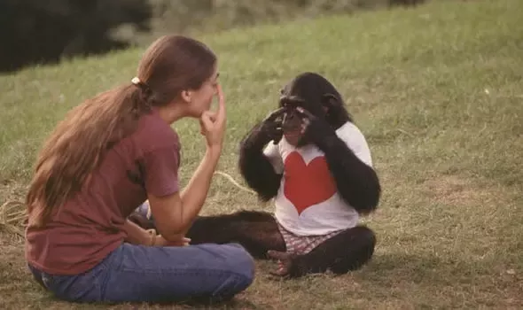

Slide 6
However…

Slide 7


Slide 8


Slide 9


Slide 10
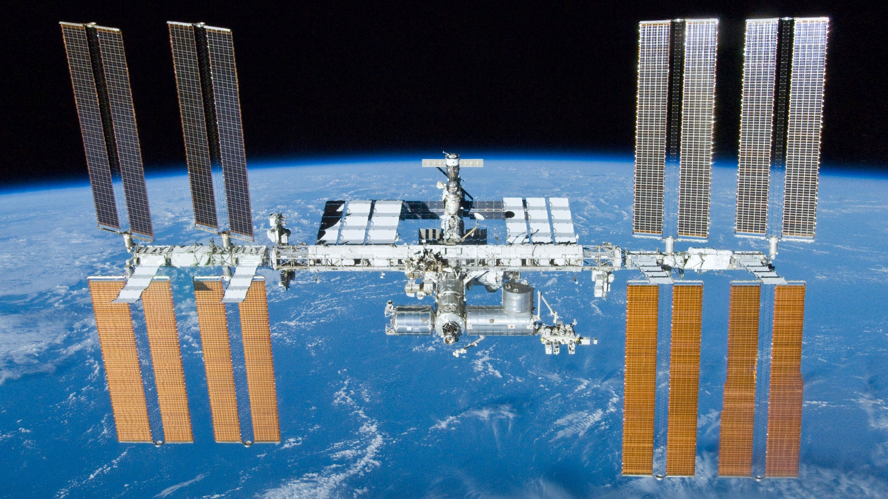

Slide 11
Vs.
Joe
George

Slide 12
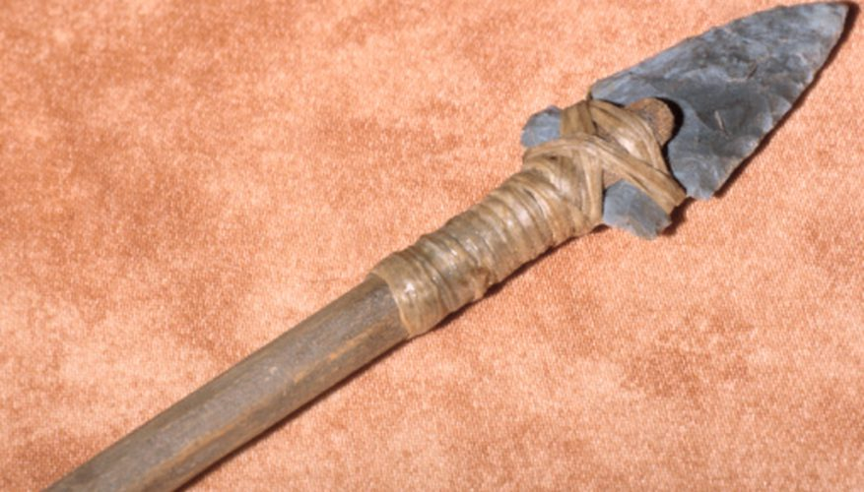
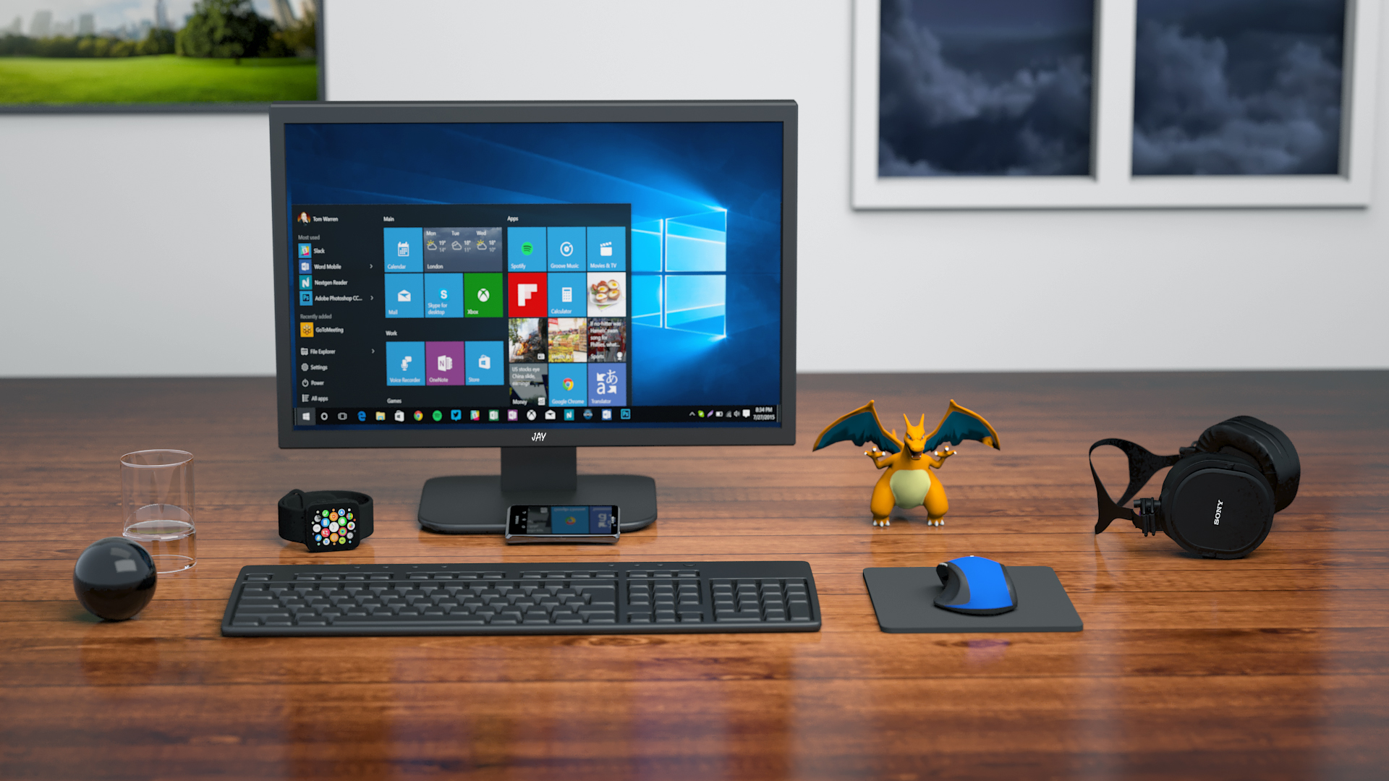
Technology
=

